Slide 1
Discovering the Story of Your Community:
How to Conduct a Well-Rounded Community Assessment
Lisa Fraser
King County Library System
Notes:
Hi, welcome to Discovering the Story of Your Community: How to Conduct a Well-Rounded Community Assessment.
I’m Lisa Fraser. I’m an organizational performance project manager at King County Library System in Washington State.
First, I’m going to very quickly review a couple of concepts from the videos. Then,
We’ll spend most of the time in this session in small groups where you’ll discuss and refine your community assessment plan.
We’ll come back at the end to share learning and wrap up.

Slide 2
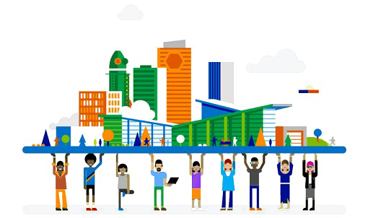
What is a Community Assessment?
Describes the people who make up the community
Reveals community needs
Identifies environmental factors and resources that might impact library services
May suggest library goals and outcomes
Demonstrates the library’s understanding to others
Notes:
Information collected in a community analysis is used to:
Create a profile of the residents of the community
Uncovers needs of the residents
Identifies assets and challenges that are present in the community
May describe desired changes that become organizational goals or program/service outcomes
Acts as a communication tool that informs others of what the library understands to be true in the community
List adapted from https://www.statelibraryofiowa.org/ld/k-p/plan/commanalysis
Mention Community-Led Libraries

Slide 3
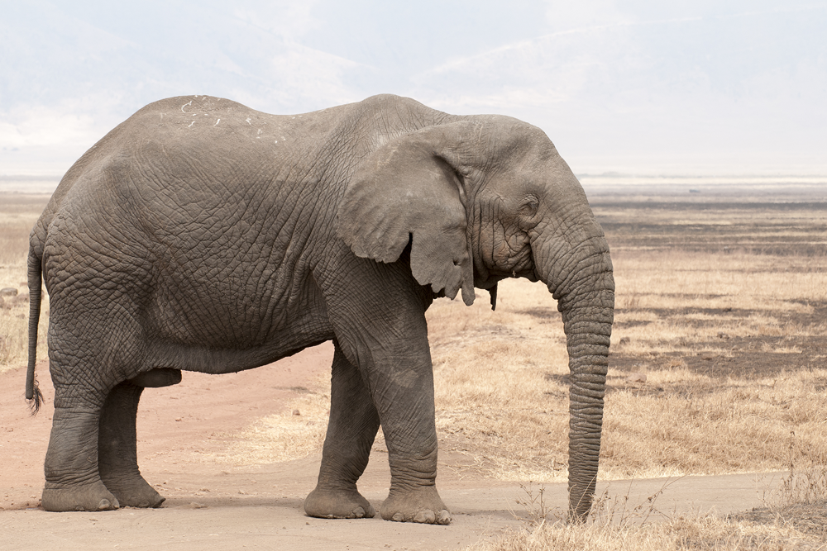
Why do community assessment?
Learn about residents who don’t use the library
Increase connections with other community organizations and groups
Align library services with community needs
Move toward community-led programs and services
Notes:
Why is it important to do community assessment?
Like the parable of the blind men and the elephant, we may develop a narrow concept of the community if we base it only on people who come to the library.
Community assessment also provides opportunities to make new connections with other organizations, community leaders, and residents
By identifying community needs, the library can be more responsive and in better alignment
Finally, it is a starting point for moving toward community-led programs and services

Slide 4
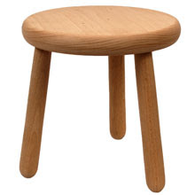
Three methods
Community Research
  Published Data Sources
Talking with people
  Interviews
  Focus groups
  Original surveys
Looking around
  Drive/walk around
  Online maps and views
Notes:
I’ll be talking about three methods of learning about your community.
First is research using published sources. This give you the big picture, and typically brings up questions that shape the next steps
Second is talking with people. This includes 1:1 interviews, focus groups, and surveys.
Third is going out and looking around your community. This might be a walk around a commercial or suburban area, or a drive around a more rural area.
Each of these methods plays a part in developing a well-rounded community assessment.
As I mentioned earlier, other RIPL presenters are going into deeper depth on several of these techniques, so check your schedule for those breakout sessions.
Let’s get started with community research.

Slide 5
Community Assessment Work Plan Activity
Research Question
Equity Considerations
Community Research Resources
Community Leader Interviews, Focus Groups, Surveys
Walk- or Drive-Around
Notes:
Your homework had these five sections, in addition to a short description of your community.
POLL – On which section of your plan would you most like to have feedback?
It looks like… [summarize the poll]
Our next activity will give you a chance to get that feedback.

Slide 6
Breakout Rooms – Homework Discussion
Assigned to groups of three
Each person take 1 minute to
  Describe your community
  Note the purpose of your community assessment
  Share which section you want feedback on
Plan out your time – 30 minutes
  3 different sections = 10 minutes each
  2 different sections = 15 minutes per section or 10 minutes per person
  1 section = 30 minutes for that section, 10 minutes per person
Use guiding questions to discuss each chosen section
Post to the chat if you need help
Notes:
You’ll be put into breakout rooms in groups of 3
When you get there, each person take just one minute to…. This is very high-level, just to sort of set the stage.
Plan your time
Breakout = 45 minutes
5 minutes to review expectations and choose section to discuss
5 minutes for each member to do intro to their community
30 minutes of discussion, 10 per section
5 minutes to wrap up discussion
Those 1-3 sections will be the focus of your group time.
For each of the sections, use the guiding questions to discuss that section in all three plans. – 30 minutes
If you have questions, send a chat and I’ll visit your room
Instructions could be in my google docs, and drop a link into the chat before sending them to the room

Slide 7
Guiding Questions for Breakout
If you are discussing… | …start with these these guiding questions
Research Question | How well does the research question fit the purpose of the assessment? Drawing on your learning at RIPL so far, how might you refine it?
Equity Considerations | How might your background & life experiences serve as assets or present limitations for your community assessment? What additional resources or steps would improve this assessment as a tool for equity research and action?
Community Research Resources | What do you expect the research to show, and how can you reduce that bias? What additional resources can you add to your plan?
Community Leader Interviews, Focus Groups, Surveys | How might you adapt your approach to center the values and cultural beliefs of the communities you want to connect with? What additional ideas do you have for reaching out to community leaders?
Walk- or Drive-Around | How will you set aside preconceived notions about your community? What information do you want to fill in by intentionally looking around?
Notes:
Breakout = 45 minutes
5 minutes to review expectations and choose section to discuss
5 minutes for each member to do intro to their community
30 minutes of discussion, 10 per section
5 minutes to wrap up discussion

Slide 8
Share one helpful bit of feedback you received or gave
Notes:
Whiteboard – use annotation tools to share one helpful piece of feedback you received from or gave to your group members
Note to self: take a screen shot of the annotations.

Slide 9
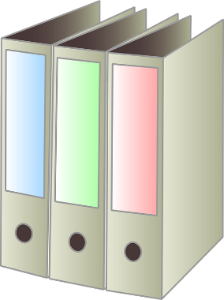
Community Assessment is Iterative
Plan
Do
Study
Adjust
Research
Connect
Observe
Synthesize & Report
What are our questions?
What sources will we use?
Who will participate?
Who is our audience?
How well did we achieve the plan?
What new questions do we have?
How have our community assessment needs changed?
Which original questions remain?
What should be the focus of the next iteration?
Process
Products
New Library
Equity
Career Progs
Notes:
Community Assessment refers to two different things: the process of gathering and synthesizing information about your community, and the products created out of that work.
The product gets a lot of attention, at least for a while, but the process can have a longer-lasting benefit because each layer builds on the ones before.
If you come out of the community assessment process with a bunch of new questions, that tells you where you should look next.
Any work that you do on community assessment is valuable.
If you can’t find the resources to use all of the steps, pick one that you CAN do. See what you can learn. Then build on that in the next round.
Do this with intention, and each iteration will take you further outside the library and into the community.
And that’s really where the public library should be.

Slide 10
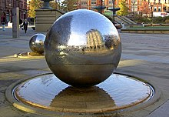
Reflection

